Slide 1
Chapter 4.2 Defensive Programming
CCSW 325 (Software Construction)
Notes:
Last Update: 22/8/2019
Version 1.0

Slide 2
Outline
Defensive Programming (Part 2 of 3)
Error-Handling Techniques

Slide 3
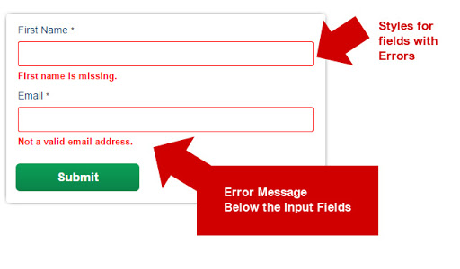
Error-Handling Techniques
Error message
Display an error message wherever the error is encountered
Beware of telling a potential attacker of the system too much. Attackers sometimes use error messages to discover how to attack a system.

Slide 4
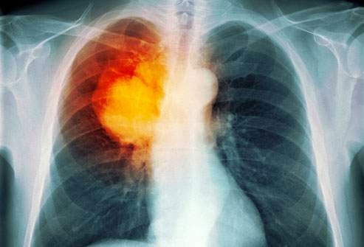
Error-Handling Techniques
Return a neutral value
Sometimes the best response to bad data is to continue operating and simply return a value that’s known to be harmless.
A numeric computation might return 0.
A string operation might return an empty string, or a pointer operation might return an empty pointer.
A drawing routine that gets a bad input value for color in a video game might use the default background or foreground color.
A drawing routine that displays x-ray data for cancer patients, however, would not want to
display a “neutral value.”

Slide 5

Error-Handling Techniques
Substitute the closest legal value
In some cases, you might choose to return the closest legal value.
Cars use this approach to error handling whenever going back. Since a speedometer doesn’t show negative speeds, when it simply shows a speed of 0—the closest legal value.

Slide 6

Error-Handling Techniques
Substitute the next piece of valid data
When processing a stream of data, some circumstances call for simply returning the next valid data.
If you’re reading records from a database and encounter a corrupted record, you might simply continue reading until you find a valid record.

Slide 7

Error-Handling Techniques
Return the same answer as the previous time
if you’re authorizing transactions at a cash machine, you probably wouldn’t want to use the “same answer as last time”—that would be the previous user’s bank account number!

Slide 8
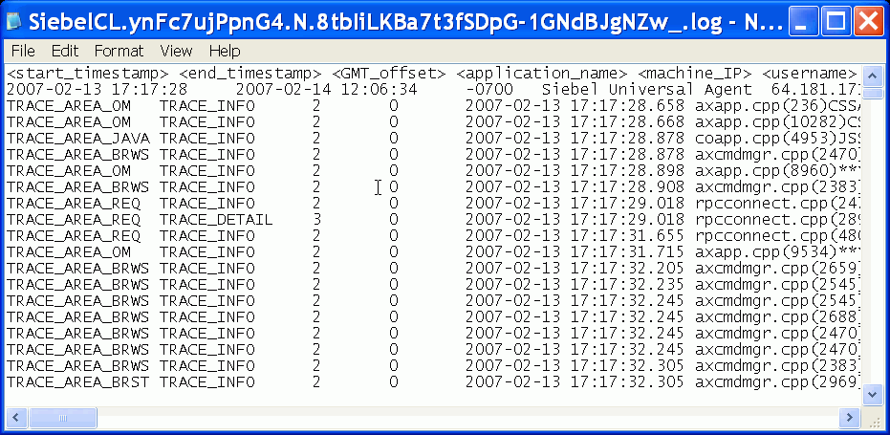
Error-Handling Techniques
Log a warning message to a file
When bad data is detected, you might choose to log a warning message to a file and then continue on.
This approach can be used in conjunction with other techniques like substituting the closest legal value or substituting the next piece of valid data.
If you use a log, consider whether you can safely make it publicly available or whether you need to encrypt it or protect it some other way.

Slide 9

Error-Handling Techniques
Shut down
Some systems shut down whenever they detect an error. This approach is useful in safety-critical applications.
Software that controls radiation equipment for treating cancer patients receives bad input data for the radiation dosage, shutting down is the best option.

Slide 10
Error-Handling Techniques: Correctness vs. Robustness
Correctness means never returning an inaccurate result; returning no result is better than returning an inaccurate result.
Safety-critical applications tend to favor correctness to robustness. It is better to return no result than to return a wrong result. e.g., the radiation machine
Robustness means always trying to do something that will allow the software to keep operating, even if that leads to results that are inaccurate sometimes.
Consumer applications tend to favor robustness to correctness. Any result whatsoever is usually better than the software shutting down.

Slide 11

Reading
Code Complete: A Practical Handbook of Software Construction, 2nd Edition, Steve McConnell.
Chapter 8

Slide 12

Any questions? ​
Please feel free to raise your hands and ask.

